Slide 1
TypeScript JavaScript + NXT
@basarat
Google

Slide 2
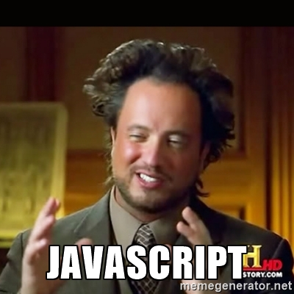

Slide 3
LESS WAT

Slide 4

WAT

Slide 5

AWWW

Slide 6

WAT

Slide 7
JavaScript
[].asdf()
TypeError:
[].asdf is not a function

Slide 8
JavaScript
[] + []

Slide 9
JavaScript
[] + []
""

Slide 10
JavaScript
[] + {}

Slide 11
JavaScript
[] + {}
"[object Object]"

Slide 12
JavaScript
{} + []
!= [] + {}

Slide 13
JavaScript
{} + []
0

Slide 14
JavaScript
{} + {}

Slide 15
JavaScript
{} + {}
V8
"[object Object][object Object]"

Slide 16
JavaScript
{} + {}
IE
NaN

Slide 17
JavaScript
"hello " + 1
hello 1

Slide 18
JavaScript
"hello " + (-1)
hello -1

Slide 19


Slide 20
JavaScript
"hello " - 1

Slide 21
JavaScript
"hello " - 1
NaN

Slide 22


Slide 23
We can lint this
"hello " - 1

Slide 24
Lint this?
function add(a,b){ return a+b }
add([], {})

Slide 25
Lint this?
function add(a,b){ return a+b }
add(foo, bar)

Slide 26
Lint this?
let foo = getServerFoo();
let bar = getServerBar();
someModule.add(foo,bar);

Slide 27

Linter on Steroids

Slide 28
JavaScript
let foo = [] + []
let bar = {} + []
let baz = [] + {}
let qux = {} + {}
let tix = "" - 123

Slide 29
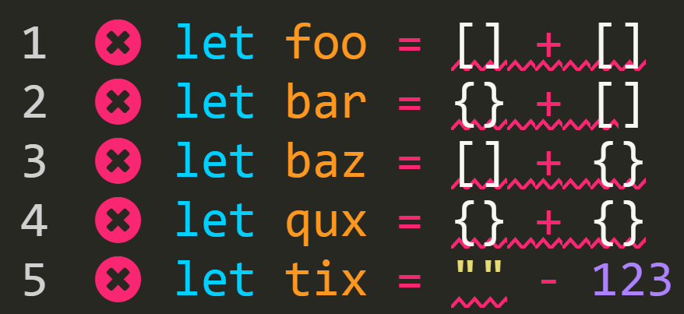
TypeScript

Slide 30

What is TypeScript?

Slide 31

Just JavaScript

Slide 32
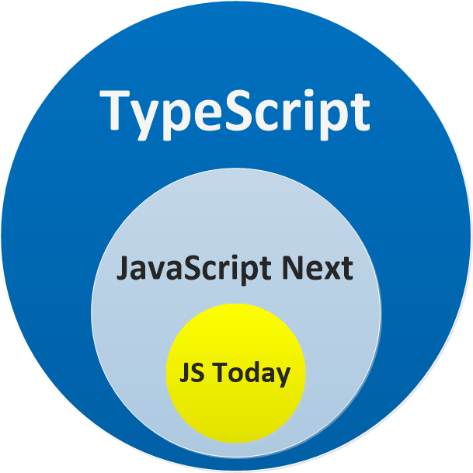

Slide 33
Linter
+
Transpiler

Slide 34
DEMO
JS File => TS File

Slide 35
Why Transpiler?

Slide 37
Quick Example
node.on('click', function() {
console.log('clicked!');
})

Slide 38
Quick Example
node.on('click', () => { console.log('clicked!');
})

Slide 39
Let / const
let funcs = [];
// create a bunch of functions
// Note the use of let
for (let i = 0; i < 3; i++) {
funcs.push(function() {
console.log(i);
})
}

Slide 40
But we won't need transpilation soon

Slide 41
The GAP
Todays JavaScript
Tomorrows JavaScript

Slide 42
Bridge
Todays JavaScript
Tomorrows JavaScript

Slide 43


Slide 44
QUESTIONS

Slide 45


alm.tools
Google:
TypeScript Book

Slide 46
@basarat

